Slide 1
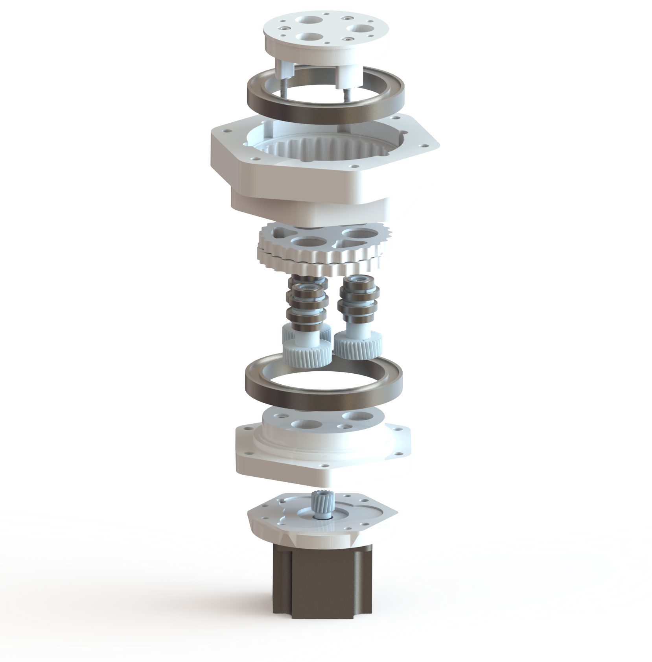
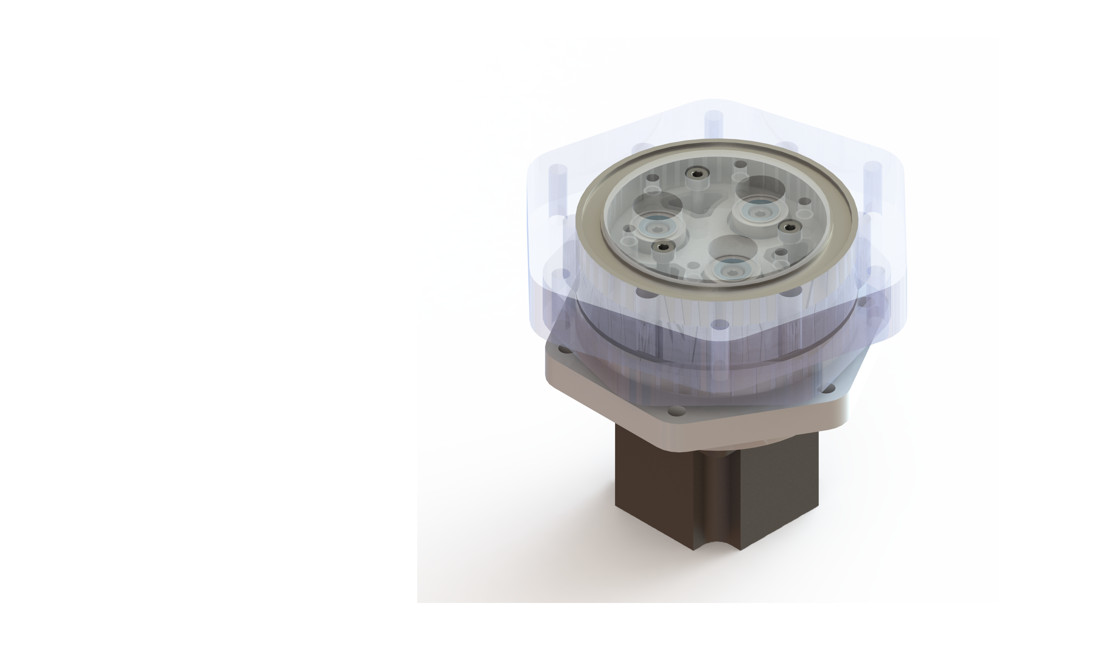
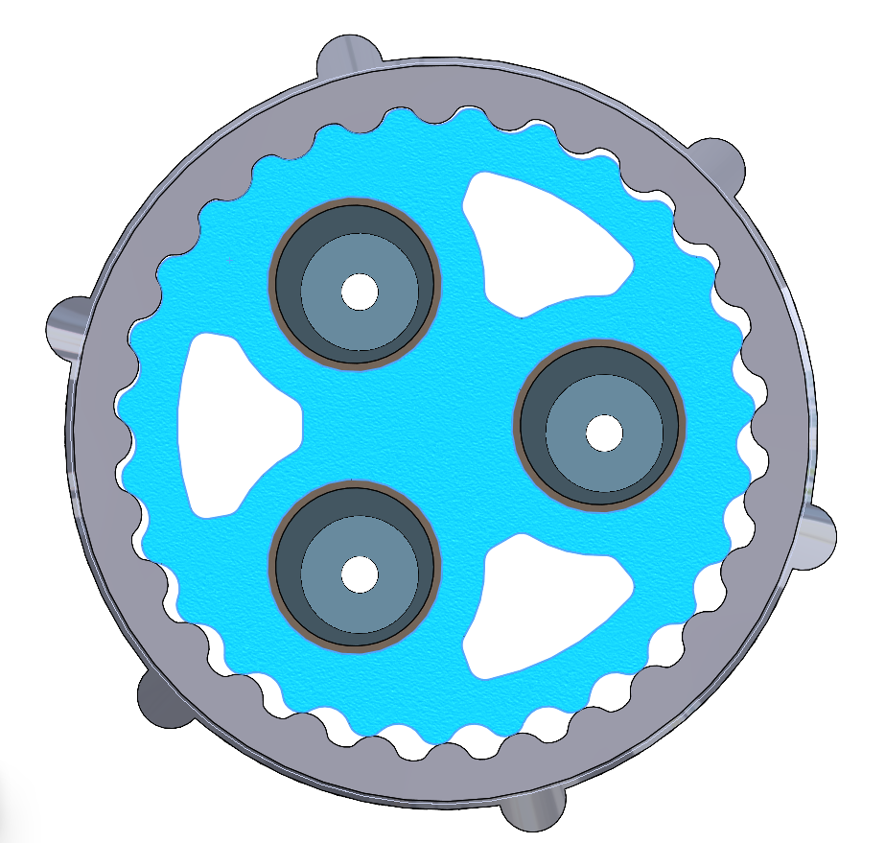
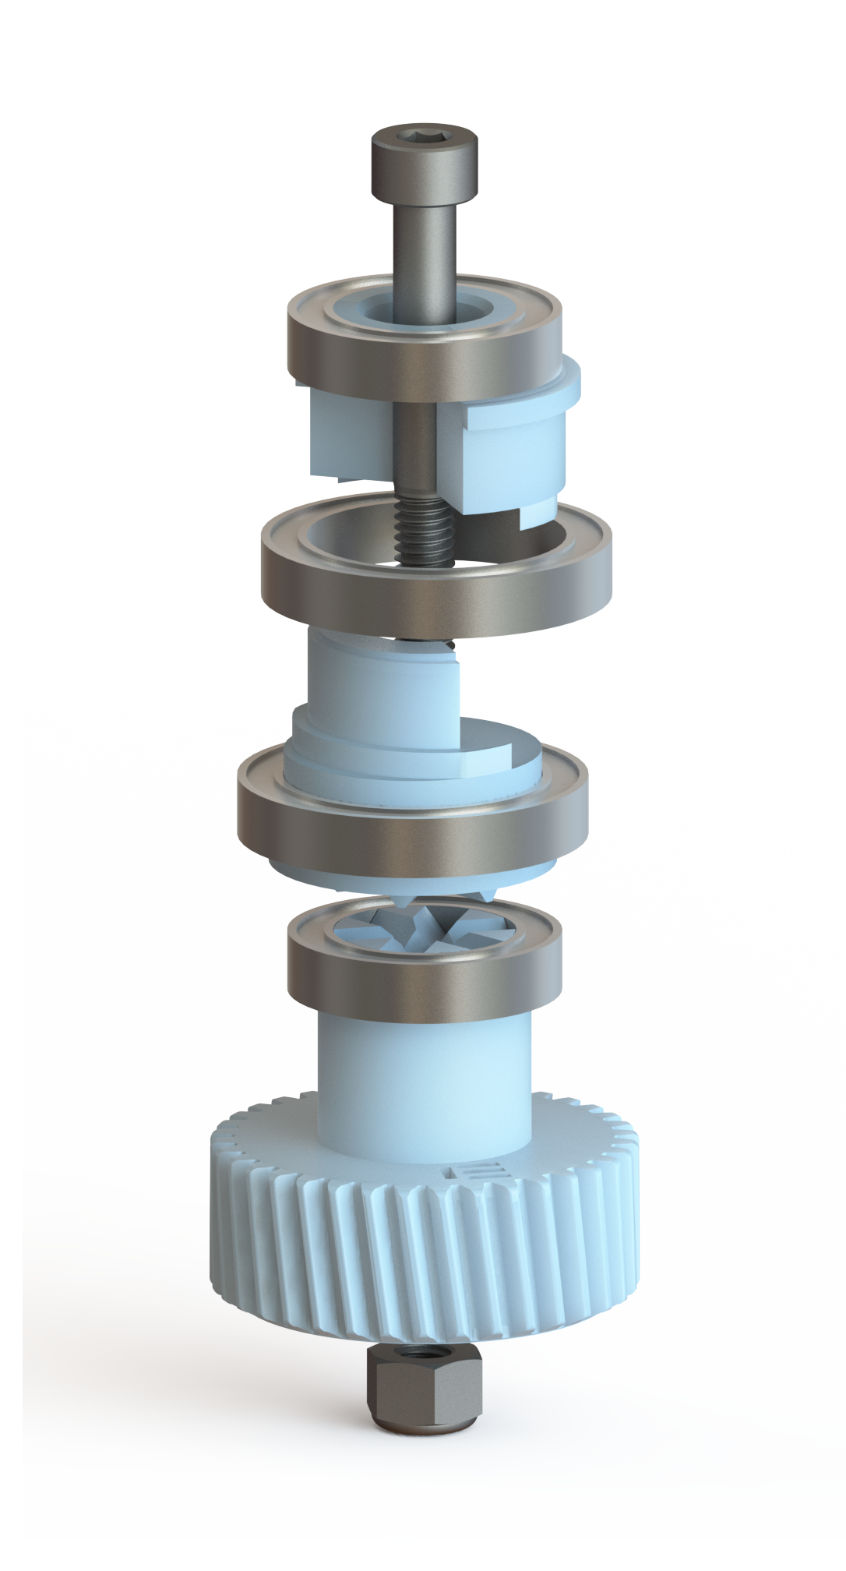

High-torque High-precision
Robotic Actuator
What?
This is an RV-Reducer, a variation on a cycloidal drive. Cycloidal drives are known for a compact reduction, minimal backlash, and a high shock resistance. All ideal when using softer materials, such as with 3D-printing. The
RV-Reducer adds three shafts and an additional reduction stage. The presented design is optimized for 3D-printing.
The assembly utilizes bolts and threaded inserts for additional reinforcement, resulting in a sturdy and compact gearbox.
The output hub is supported using double bearings.
Cycloidal drives have multiple teeth in contact at once, spreading the load more evenly. One rotation of the eccentric shaft moves the disk over one tooth. This provides a compact reduction. Two disks are used to balance vibrations.
The eccentric shaft rotates and causes the cycloidal disk to wobble as needed. Multiple parts lock the bearings in place. It is reinforced with a bolt for higher strength.
Why?
Robotics require actuators with high torque and high precision. This requires high reduction gearboxes. Regular spur gears cause backlash, and the single teeth contact forms a weak spot. Some modern gearbox designs fix this, but they are often expensive. This 3D-printable version is easier to recreate and makes high-end robotics more accessible for everyone.
Combined reduction of 63:1. Resulting in higher torque and precision at the output.
A standard Nema23 stepper motor is used as input. But alternative mounting plates make it easy to use other motors for higher speeds or closed loop control.
3D-printed gearbox enabling DIY robotics
Jelmer Volbeda
13-06-2023
https://www.utwente.nl/en/ces/celt/sutq/

Slide 2
High-torque High-precision
Robotic Actuator
Why?
Robotics require actuators with high torque and high precision. This requires high reduction gearboxes. Regular spur gears introduce backlash, and the single teeth contact forms a weak spot. Some modern gearbox designs fix this, but they are often expensive. This 3D-printable version is easier to recreate and makes high-end robotics more accessible.
The frame is held together using bolts and threaded inserts. Those also function as reinforcements.
On the cycloidal disk multiple teeth contact at once, distributing loads. One rotation of the eccentric shaft cause the disk to move one teeth over. Resulting in a compact reduction. Two disks are used to balance vibrations.
The output hub is supported using double bearings.
The eccentric shaft rotates and causes the cycloidal disk to wobble as needed. Multiple parts lock the bearings in place. It's reinforced with a bolt for higher strength.
What?
This is an RV-Reducer, a variation on a cycloidal drive. Cycloidal drives are known for a compact reduction, minimal backlash, and a high shock resistance. All ideal when using softer materials, such as with 3D-printing. The RV-Reducer adds three shafts and an additional reduction stage. The presented design is optimized for 3D-printing.
Combined reduction of 70:1. Meaning: A higher torque and higher precision output.
A standard Nema23 stepper motor is used as input. But alternative mounting plates make it easy to use other motors for higher speeds or closed loop control.
3D-printed gearbox enabling DIY robotics
Jelmer Volbeda
13-06-2023
https://www.utwente.nl/en/ces/celt/sutq/

Slide 3
High-torque High-precision
Robotic Actuator
Why?
Robotics require actuators with high torque and high precision. This requires high reduction gearboxes. Regular spur gears introduce backlash, and the single teeth contact forms a weak spot. Some modern gearbox designs fix this, but they are often expensive. A 3d-printable version is easier to recreate and makes high-end robotics more accessible.
Bolts reinforce the frame. And hold everything together using threaded inserts.
On the cycloidal disk multiple teeth contact at once, distributing loads. One rotation of the eccentric shaft cause the disk to move one teeth over. Resulting in a compact reduction. Two disks are used to balance vibrations.
Double bearings support the output.
The eccentric shaft rotates and causes the cycloidal disk to wobble as needed. Multiple parts lock the bearings in place. It's reinforced with a bolt for higher strength.
What?
This is an RV-Reducer, a variation on a cycloidal drive. Cycloidal drives are known for a compact reduction, minimal backlash, and a high shock resistance. All ideal when using softer materials, such as with 3d-printing. The RV-reducer adds thee shafts and an additional reduction stage. The presented design is optimized for 3d printing.
Combined reduction of 70:1. Meaning higher torque and higher precision output.
A standard Nema23 stepper motor is used as input. Alternatively, a BLDC can be used for more speed and to make it back drivable.
A 3D-printed gearbox enabling DIY robotics.
Jelmer Volbeda
Date: 13-06-2023
https://www.utwente.nl/en/ces/celt/sutq/

